Slide 1
Melting: This is the process of changing a substance from the solid state to the liquid state.
The reverse of melting is freezing.
Vaporizing: This is the process of changing a substance from the liquid state to the vapor (gas) state.
The reverse of vaporizing is condensing.

Slide 2
Heat of Transformation: The amount of energy per unit mass that must be transferred as heat when a sample completely undergoes a phase change is called the heat of transformation L.
$$∴L=\frac{Q}{m}$$

Slide 3
Latent heat of fusion: The amount of heat energy per unit mass to change the phase of an object from solid to liquid is called the latent heat of fusion.
$$L_{f}=\frac{Q}{m}$$
Unit: J/Kg or cal/gm.
Latent heat of vaporization: The amount of heat energy per unit mass to change the phase of an object from liquid to gas is called the latent heat of vaporization.
$$L_{v}=\frac{Q}{m}$$
Unit: J/Kg or cal/gm.

Slide 4

Transfer of Energy as heat and work
Initial State
$$P_{i},V_{i},T_{i}$$
Final State
$$P_{f},V_{f},T_{f}$$
Thermodynamic Process
Thermal Reservoir
During such a process, energy may be transferred into the system from the thermal reservoir (positive heat) or vice versa (negative heat).
Also, work can be done by the system to raise the piston (positive work) or lower it (negative work)

Slide 5
Work Done By Ideal Gas at Constant Pressure
Consider an ideal gas is in a cylinder with a piston.
We move the piston upward by a small displacement ds allowing the gas to apply a force F on the piston.
Let, P is the pressure of the gas and A is the face area of the piston.
Then the work done by the gas,
$$dW=\vec{F}.\vec{ds}$$
$$⇒dW=\left(PA\right)ds$$
ds
$$⇒dW=P(Ads)$$
$$⇒dW=P dv$$

Slide 6
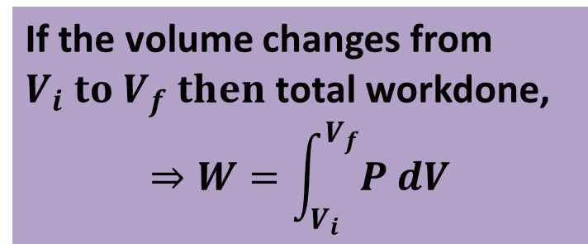

Slide 7


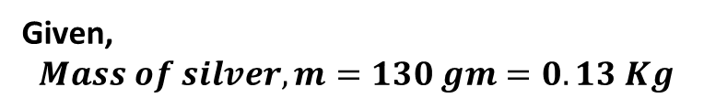





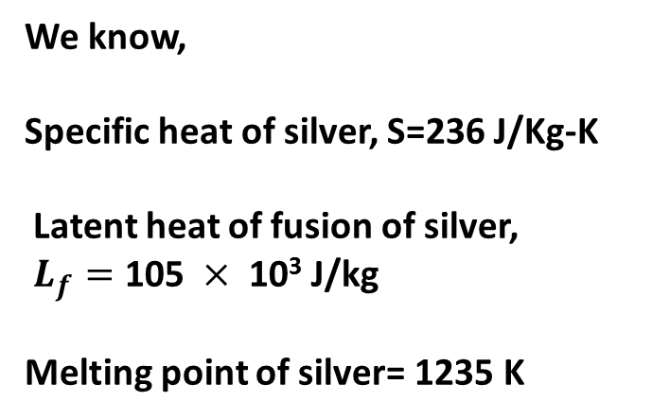
Problem 27 : Calculate the minimum amount of energy, in joules, required to completely melt 130 g of silver initially at 15.0° C. 2.91 $×$ 10⁴ J L_{F} = 105 $×$ 10³ J/kg 1.36 $×$ 10⁴ J 4.27 $×$ 10⁴
We know,
Specific heat of silver, S=236 J/Kg-K
Latent heat of fusion of silver,
$L_{f}=\text{105} ×\text{ 10}\text{3} \text{J}\text{/}\text{kg}$
Melting point of silver= 1235 K
Solid silver at 288 K$→$Solid silver at 1235 K
$$Q_{1}=mS∆T$$
$$=0.13×236×\left(1235−288\right)=\text{2.91 }×\text{ 10}\text{4 }\text{J}$$
Solid silver at 1235 K$→$Liquid silver at 1235 K
$$Q_{2}=mL_{f}$$
Given,
$$Mass of silver, m=130 gm=0.13 Kg$$
$$=0.13×\text{105}×{10}^{3}=\text{1.36 }×\text{ 10}\text{4 }\text{J}$$
Initial temperature=${15}^{0} C=288 K$
Total energy,
Energy, $Q=?$
$Q=Q_{1}+Q_{2}=\text{4.27 }×\text{ 10}\text{4}$ J

Slide 8
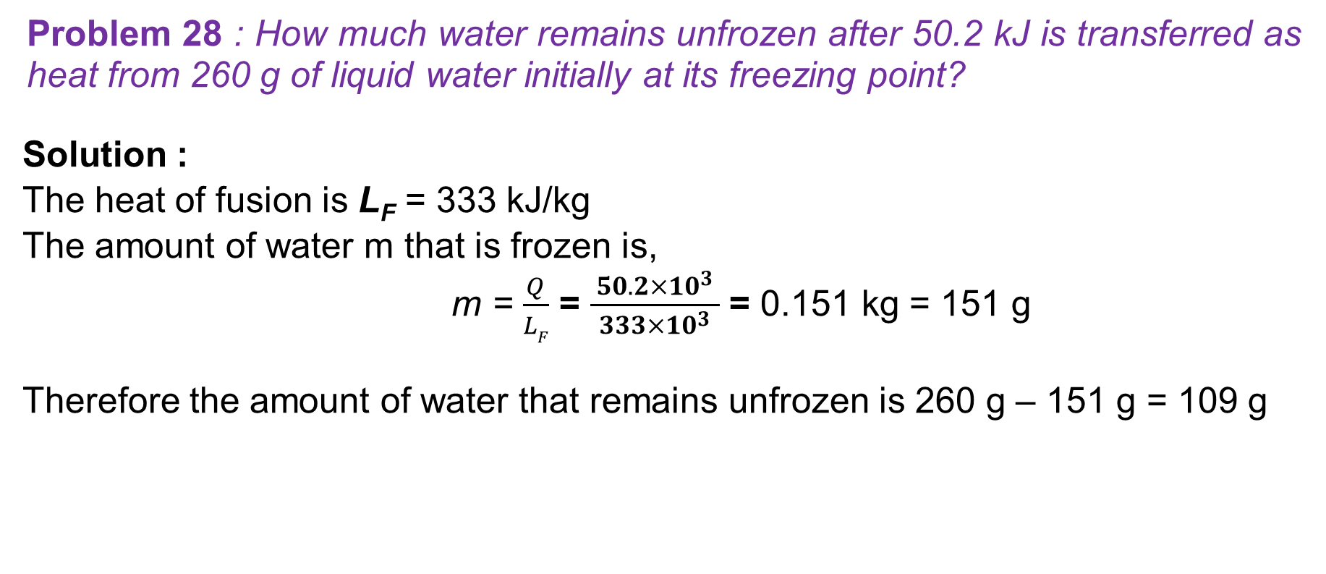
Problem 28 : How much water remains unfrozen after 50.2 kJ is transferred as heat from 260 g of liquid water initially at its freezing point?
Solution :
The heat of fusion is L_{F} = 333 kJ/kg
The amount of water m that is frozen is,
m = $\frac{Q}{LF}$ = $\frac{ 50.2{×10}^{3} }{333{×10}^{3}}$ = 0.151 kg = 151 g
Therefore the amount of water that remains unfrozen is 260 g – 151 g = 109 g

